Slide 1
Tactics for Building Background Services in .NET
Kevin Griffin

Slide 2


Slide 3


Slide 4
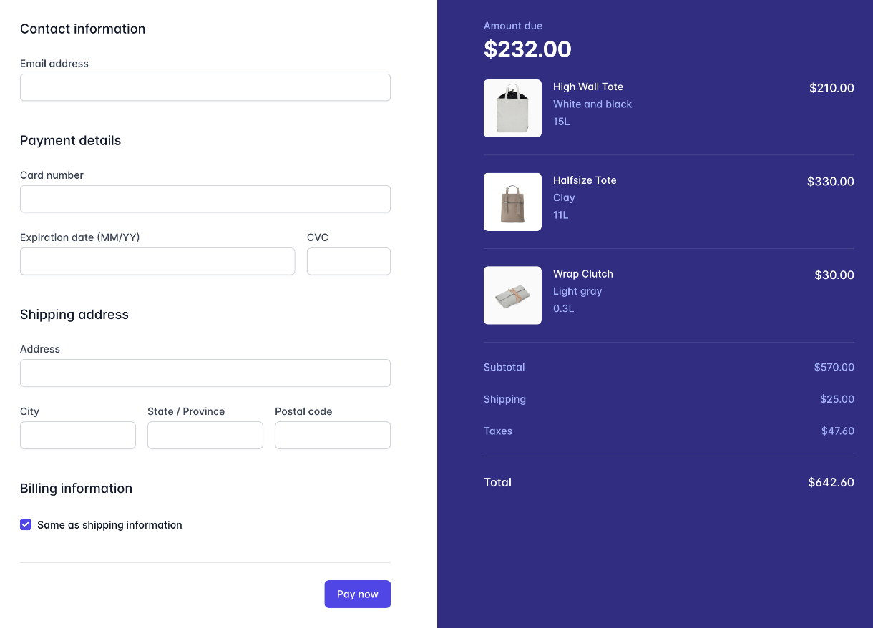

Slide 5

Create Order
Check Inventory
Charge Credit Card
Send Email

Slide 6
Create Order
Check Inventory
Charge Credit Card
Send Email
🔥🔥🔥

Slide 7

Hi, I’m Kevin

Slide 8
Kevin Griffin 14-time Microsoft MVP ASP.NET Core, Azure, and Web consultwithgriff.com twitter.com/@1kevgriff bbiz.io/@1kevgriff

Slide 9

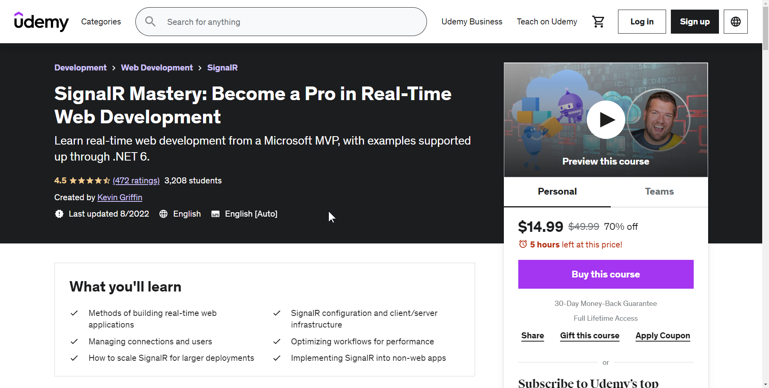
Courses

Slide 10

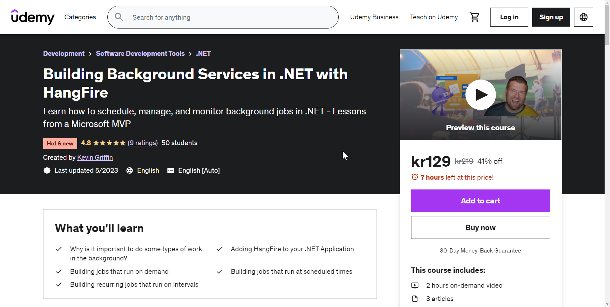
Courses
CODEMASH2024

Slide 11

Agenda
Background Tasks
Notes:
Adding tools to your tool box

Slide 12
Create Order
Check Inventory
Charge Credit Card
Send Email
🔥🔥🔥

Slide 13
Create Order
Check Inventory
Charge Credit Card
Send Email
Notes:
We have a big di

Slide 14

Background Tasks
On Demand
Processes that need to occur now
Might be a workflow
Examples:
Transactional Emails
Payment Processing
Webhooks
Entity Processing

Slide 15

Background Tasks
Recurring or Scheduled Task
Tasks that need to happen on a schedule
Hourly, Daily, Weekly, etc
Examples:
Reports
Resource Cleanup

Slide 16
Considerations
Where are you hosting?
Local
Windows Service
Inside existing client app
Web
ASP.NET Core app
Microsoft Azure PAAS

Slide 17
Considerations
Resiliency
What happens if a task fails?
What happens if a service crashes?

Slide 18
Agenda
Background Tasks
Tactics
Hosted Services
Windows Services
ASP.NET Core Hosted Services
Quartz
HangFire
Azure Functions

Slide 19
.NET Hosted Services

Slide 20
.NET Hosted Services
.NET Host
Hosted Service
Hosted Service
Hosted Service
Hosted Service
Hosted Service

Slide 21
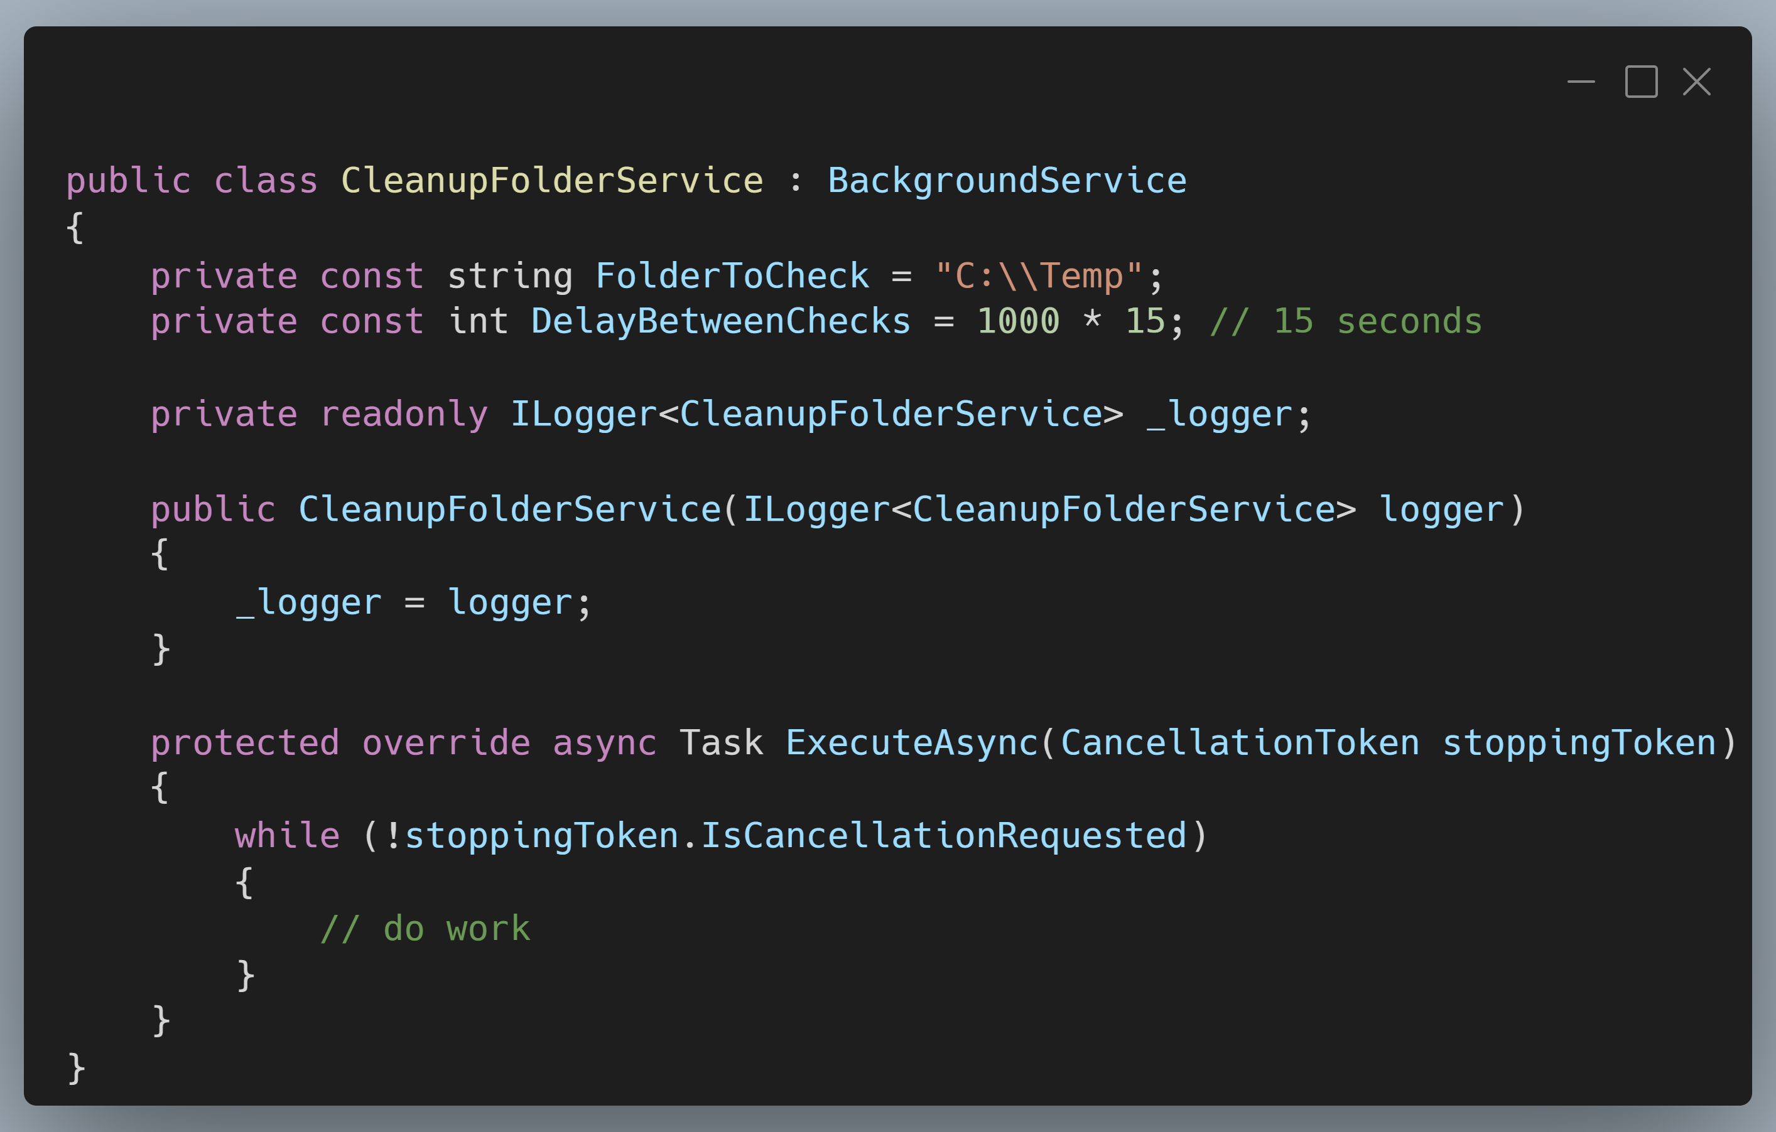
.NET Hosted Services
Notes:
Introduce concept of hosted services
Examples in .NET Console and ASP.NET Core
Screenshot: https://carbon.now.sh/?bg=rgba%28171%2C+184%2C+195%2C+1%29&t=vscode&wt=boxy&l=text%2Fx-csharp&width=680&ds=true&dsyoff=20px&dsblur=68px&wc=true&wa=true&pv=11px&ph=10px&ln=false&fl=1&fm=Hack&fs=14px&lh=133%25&si=false&es=4x&wm=false&code=public%2520class%2520CleanupFolderService%2520%253A%2520BackgroundService%250A%257B%250A%2520%2520%2520%2520private%2520const%2520string%2520FolderToCheck%2520%253D%2520%2522C%253A%255C%255CTemp%2522%253B%250A%2520%2520%2520%2520private%2520const%2520int%2520DelayBetweenChecks%2520%253D%25201000%2520*%252015%253B%2520%252F%252F%252015%2520seconds%250A%250A%2520%2520%2520%2520private%2520readonly%2520ILogger%253CCleanupFolderService%253E%2520_logger%253B%250A%250A%2520%2520%2520%2520public%2520CleanupFolderService%28ILogger%253CCleanupFolderService%253E%2520logger%29%250A%2520%2520%2520%2520%257B%250A%2520%2520%2520%2520%2520%2520%2520%2520_logger%2520%253D%2520logger%253B%250A%2520%2520%2520%2520%257D%250A%250A%2520%2520%2520%2520protected%2520override%2520async%2520Task%2520ExecuteAsync%28CancellationToken%2520stoppingToken%29%250A%2520%2520%2520%2520%257B%250A%2520%2520%2520%2520%2520%2520%2520%2520while%2520%28%21stoppingToken.IsCancellationRequested%29%250A%2520%2520%2520%2520%2520%2520%2520%2520%257B%250A%2520%2520%2520%2520%2520%2520%2520%2520%2509%252F%252F%2520do%2520work%250A%2520%2520%2520%2520%2520%2520%2520%2520%257D%250A%2520%2520%2520%2520%257D%250A%257D

Slide 22
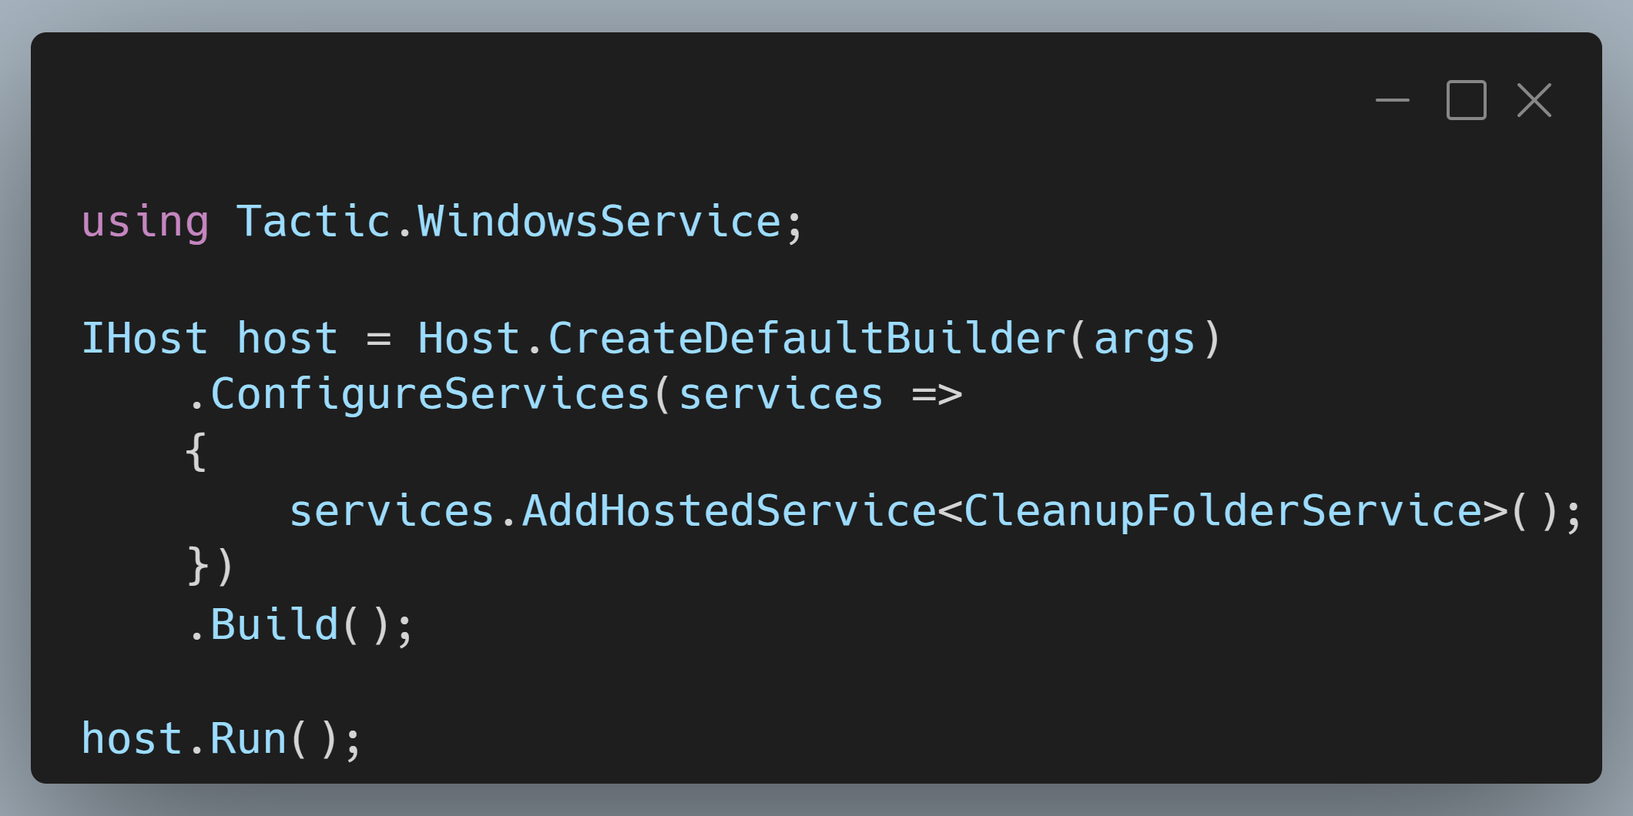
.NET Hosted Services
Notes:
Screenshot: https://carbon.now.sh/?bg=rgba%28171%2C+184%2C+195%2C+1%29&t=vscode&wt=boxy&l=text%2Fx-csharp&width=680&ds=true&dsyoff=20px&dsblur=68px&wc=true&wa=true&pv=11px&ph=10px&ln=false&fl=1&fm=Hack&fs=14px&lh=133%25&si=false&es=4x&wm=false&code=using%2520Tactic.WindowsService%253B%250A%250AIHost%2520host%2520%253D%2520Host.CreateDefaultBuilder%28args%29%250A%2520%2520%2520%2520.ConfigureServices%28services%2520%253D%253E%250A%2520%2520%2520%2520%257B%250A%2520%2520%2520%2520%2520%2520%2520%2520services.AddHostedService%253CCleanupFolderService%253E%28%29%253B%250A%2520%2520%2520%2520%257D%29%250A%2520%2520%2520%2520.Build%28%29%253B%250A%250Ahost.Run%28%29%253B

Slide 23
Windows Service

Slide 24
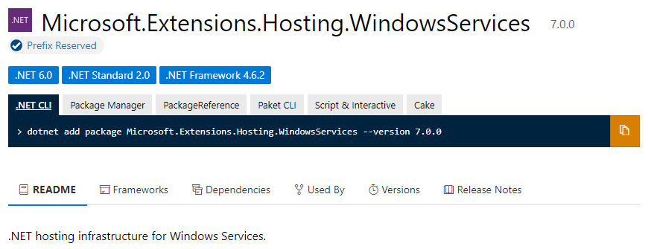
Windows Services

Slide 25
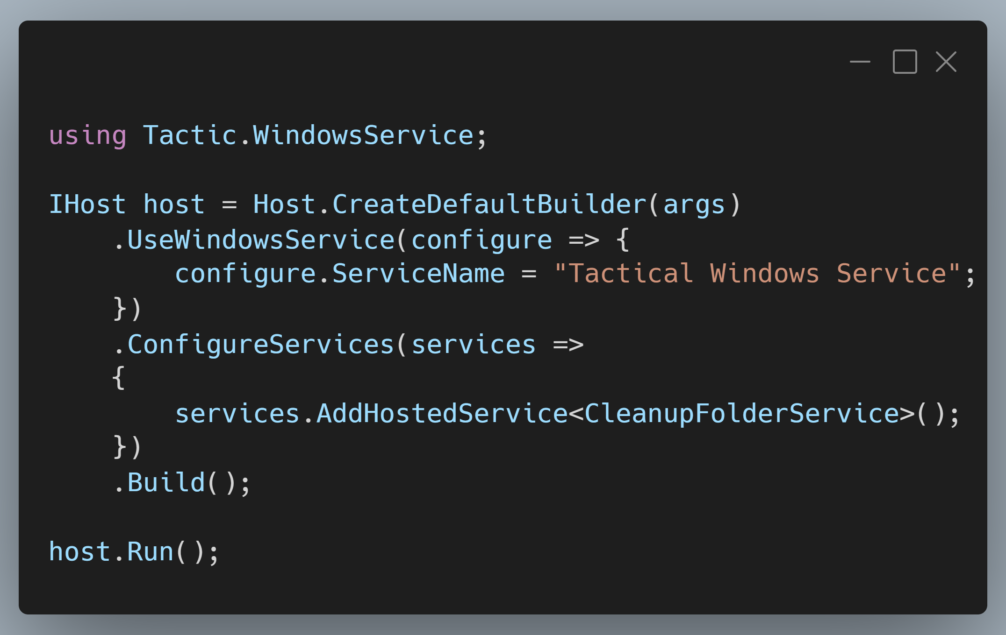
Windows Services
Notes:
Screenshot: https://carbon.now.sh/?bg=rgba%28171%2C+184%2C+195%2C+1%29&t=vscode&wt=boxy&l=text%2Fx-csharp&width=680&ds=true&dsyoff=20px&dsblur=68px&wc=true&wa=true&pv=11px&ph=10px&ln=false&fl=1&fm=Hack&fs=14px&lh=133%25&si=false&es=4x&wm=false&code=using%2520Tactic.WindowsService%253B%250A%250AIHost%2520host%2520%253D%2520Host.CreateDefaultBuilder%28args%29%250A%2520%2520%2520%2520.UseWindowsService%28configure%2520%253D%253E%2520%257B%250A%2520%2520%2520%2520%2520%2520%2520%2520configure.ServiceName%2520%253D%2520%2522Tactical%2520Windows%2520Service%2522%253B%250A%2520%2520%2520%2520%257D%29%250A%2520%2520%2520%2520.ConfigureServices%28services%2520%253D%253E%250A%2520%2520%2520%2520%257B%250A%2520%2520%2520%2520%2520%2520%2520%2520services.AddHostedService%253CCleanupFolderService%253E%28%29%253B%250A%2520%2520%2520%2520%257D%29%250A%2520%2520%2520%2520.Build%28%29%253B%250A%250Ahost.Run%28%29%253B%250A

Slide 26
Demo
Windows Services
Notes:
### Create the Windows Service
At the COMMAND PROMPT (as Administrator), run the command:
```bash
sc create Tactic.WindowsService binPath= "{path to your application}\Tactic.WindowsService\publish\Tactic.WindowsService.exe"
```
### Start the Windows Service
At the COMMAND PROMPT (as Administrator), run the command:
```bash
sc start Tactic.WindowsService
```
### Stop the Windows Service
At the COMMAND PROMPT (as Administrator), run the command:
```bash
sc stop Tactic.WindowsService
```

Slide 27
Window Services
Pros
Easy to build!
Windows will automatically manage lifecycle for you
Cons
Limited to single machine/server
Not straight forward to do “on-demand” work
You’re responsible for resiliency of individual tasks

Slide 28
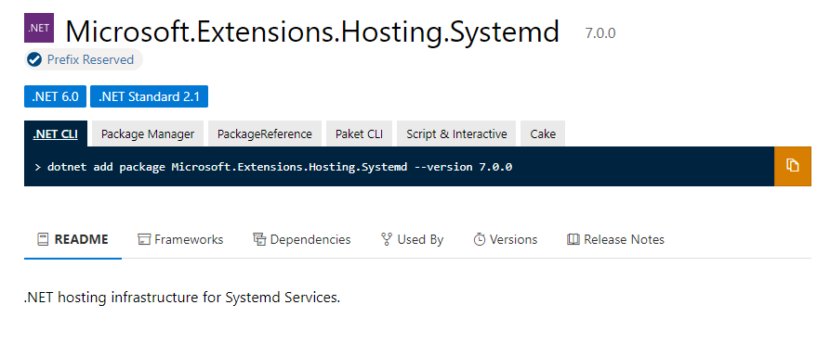
Linux?

Slide 29
ASP.NET Core Hosted Services

Slide 30
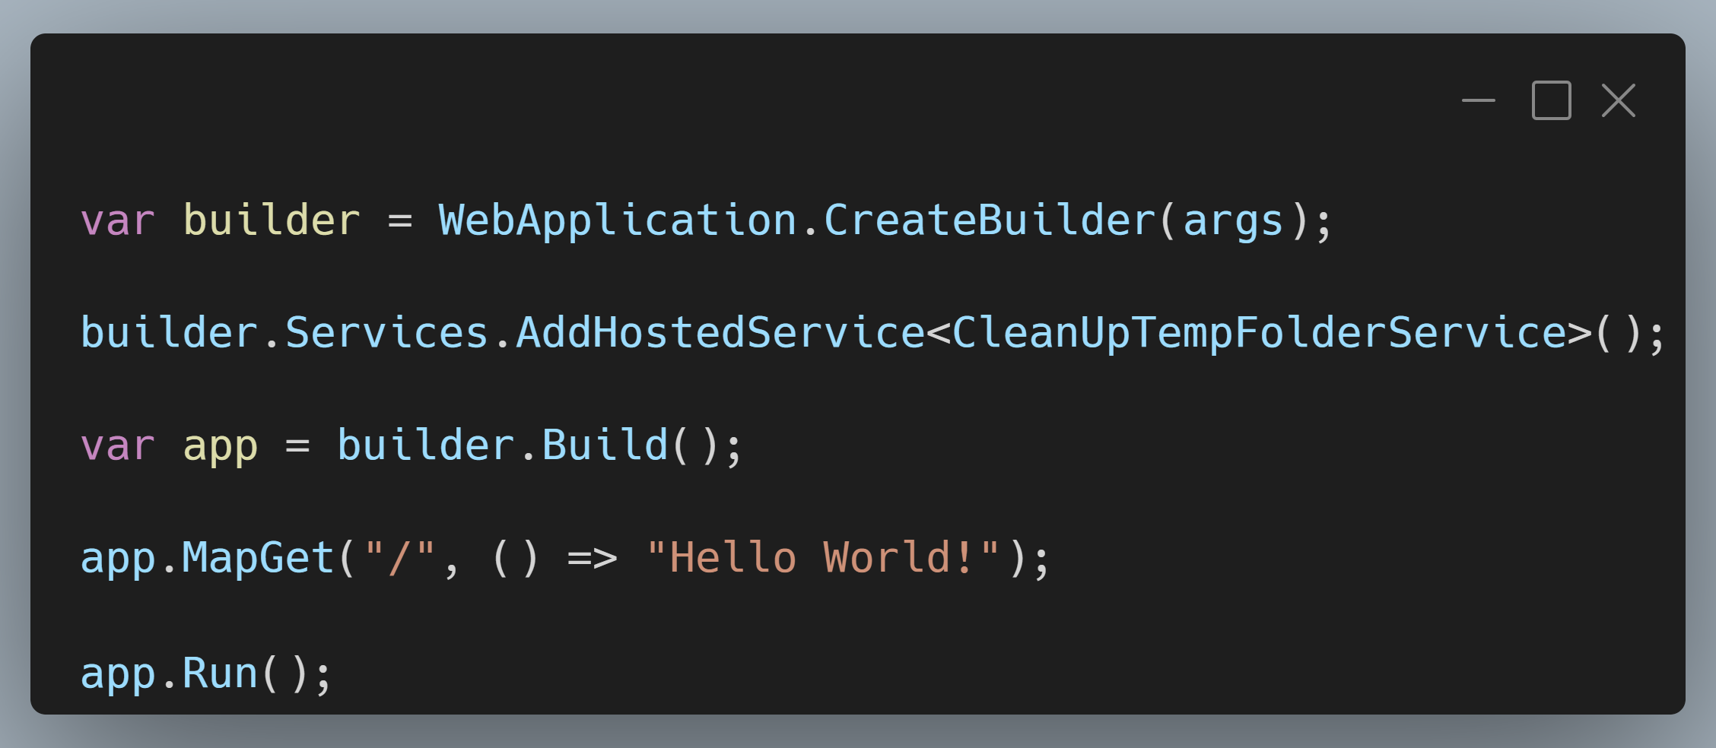
ASP.NET Core Hosted Services
Notes:
SCREENSHOT: https://carbon.now.sh/?bg=rgba%28171%2C+184%2C+195%2C+1%29&t=vscode&wt=boxy&l=text%2Fx-csharp&width=680&ds=true&dsyoff=20px&dsblur=68px&wc=true&wa=true&pv=11px&ph=10px&ln=false&fl=1&fm=Hack&fs=14px&lh=133%25&si=false&es=4x&wm=false&code=var%2520builder%2520%253D%2520WebApplication.CreateBuilder%28args%29%253B%250A%250Abuilder.Services.AddHostedService%253CCleanUpTempFolderService%253E%28%29%253B%250A%250Avar%2520app%2520%253D%2520builder.Build%28%29%253B%250A%250Aapp.MapGet%28%2522%252F%2522%252C%2520%28%29%2520%253D%253E%2520%2522Hello%2520World%21%2522%29%253B%250A%250Aapp.Run%28%29%253B

Slide 31
Demo
ASP.NET Core Hosted Services

Slide 32
ASP.NET Core Hosted Services
Pros
Easy to build!
Runs inside of your existing ASP.NET Core Host
Automatically starts on app startup
Cons
You’re responsible for scheduling (with Quartz or custom process)
You’re responsible for resiliency of individual tasks

Slide 33
Quartz

Slide 34
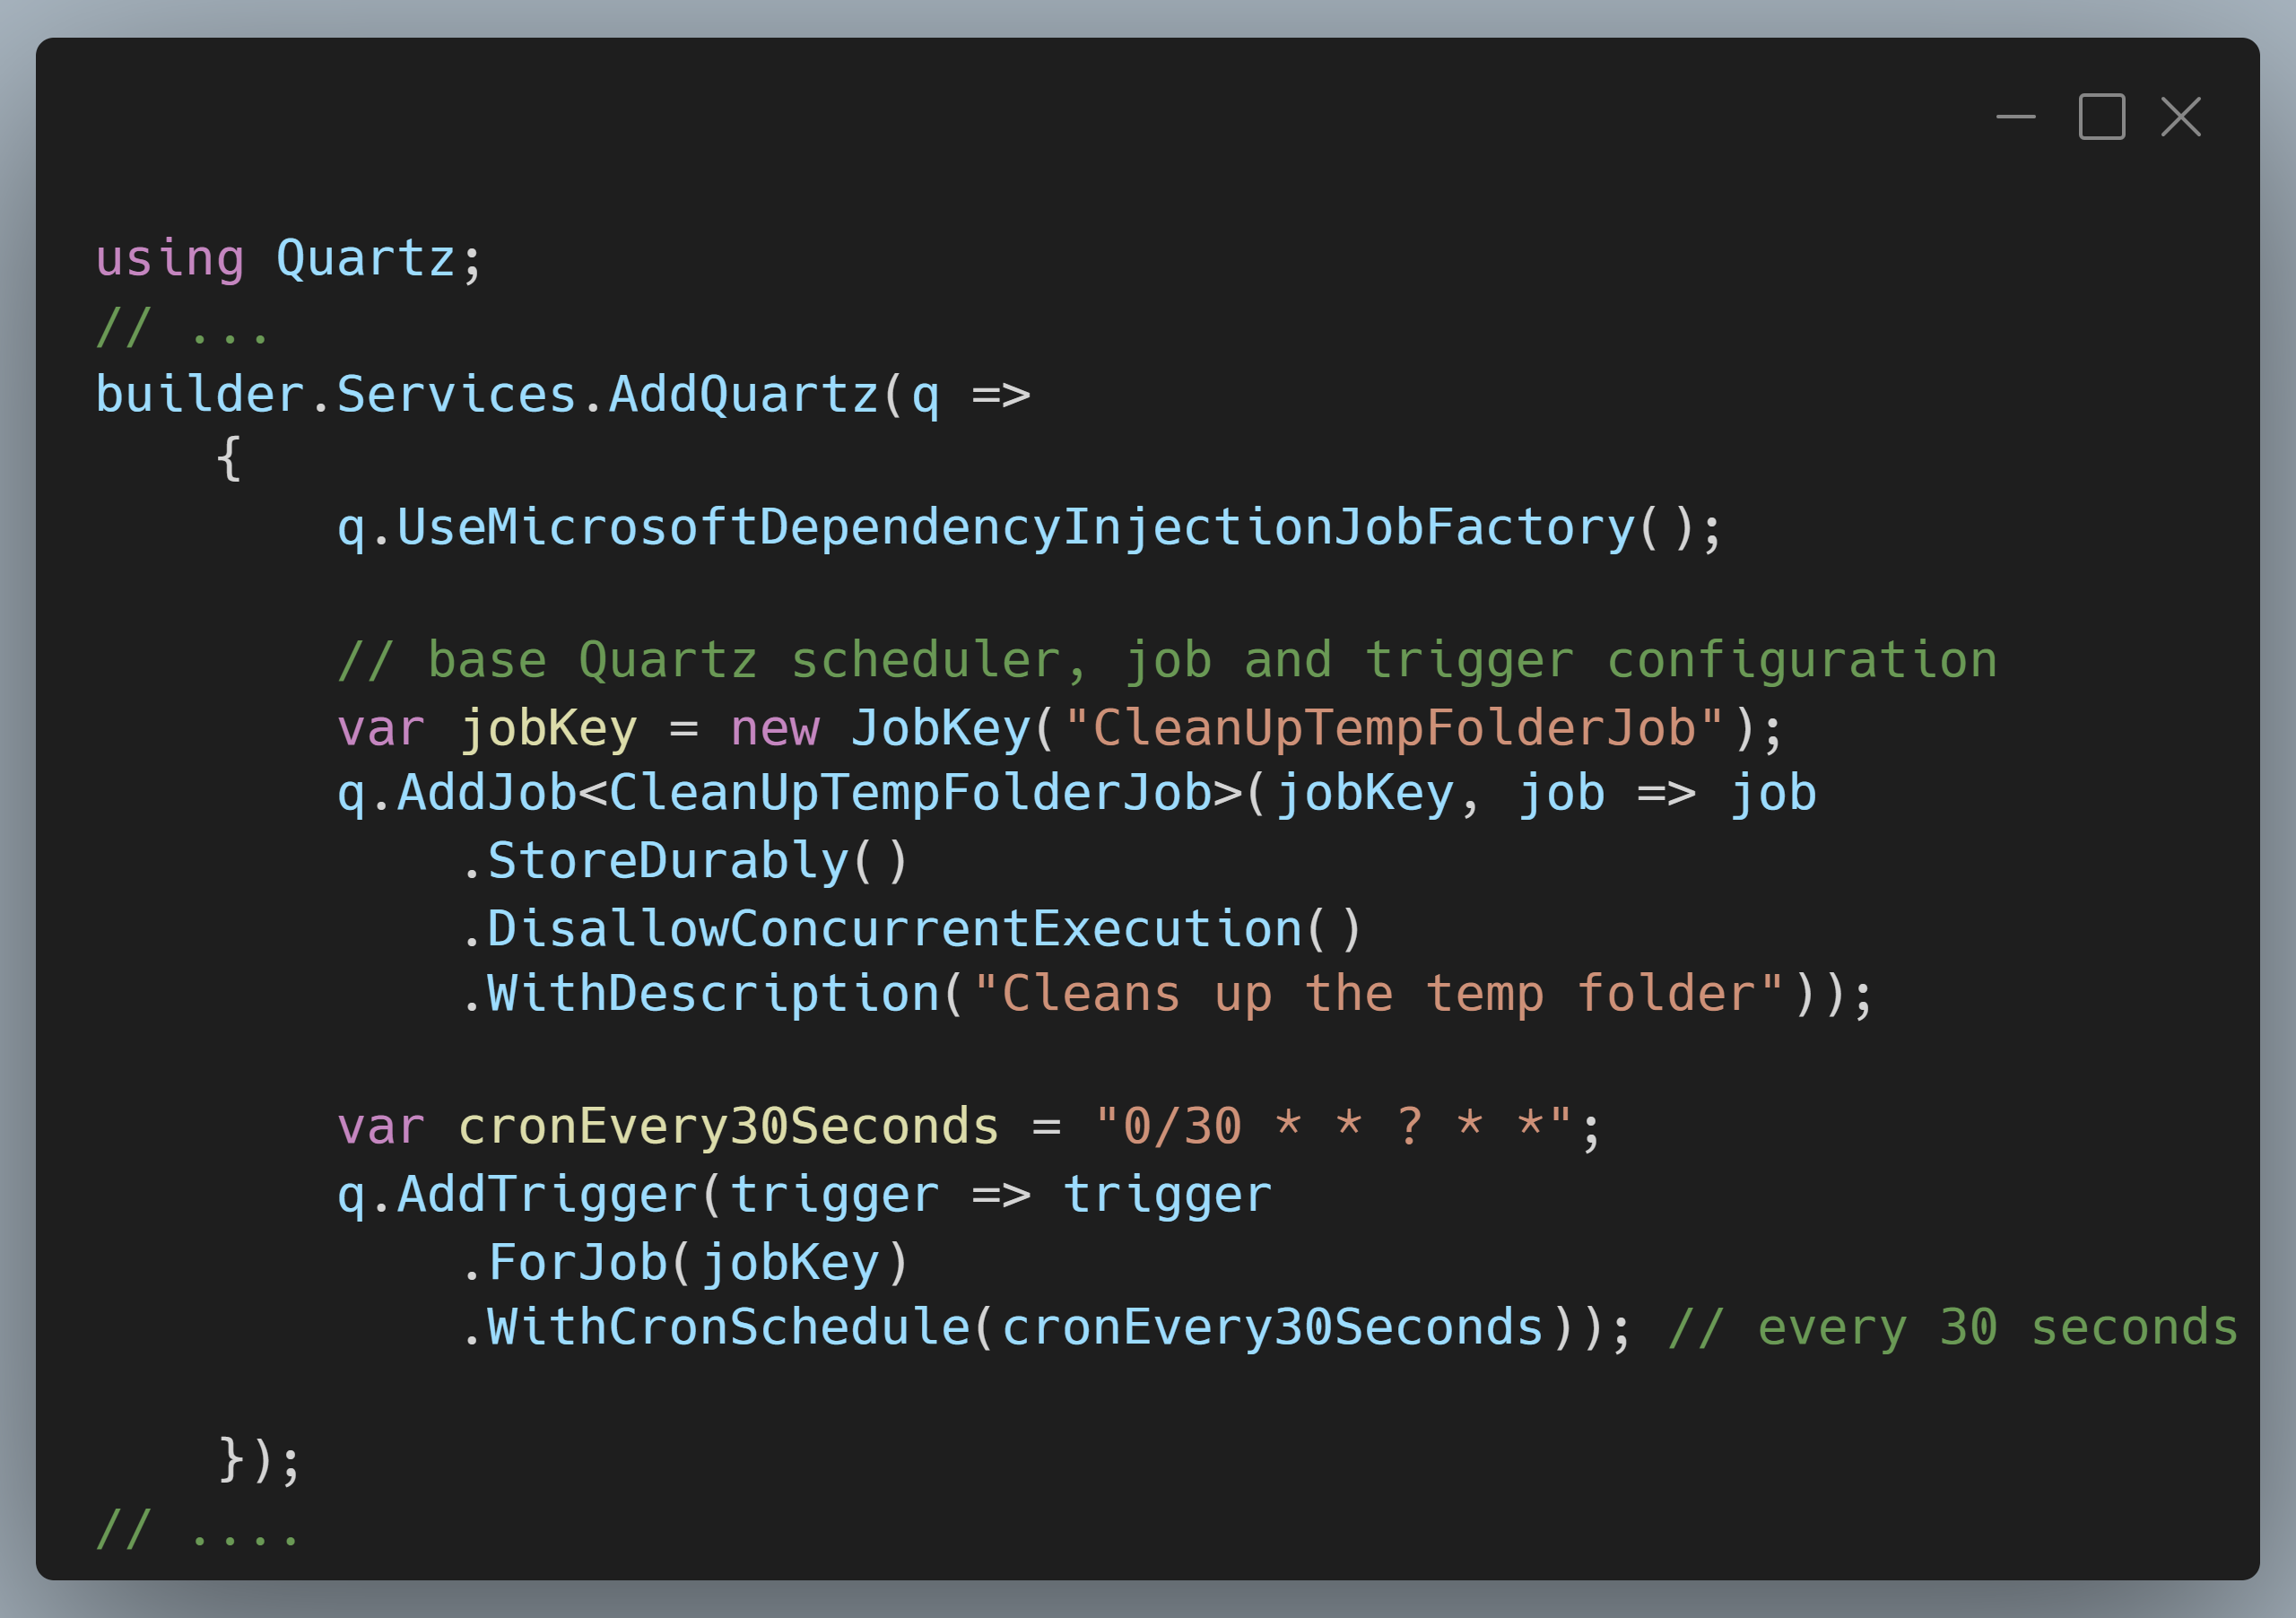
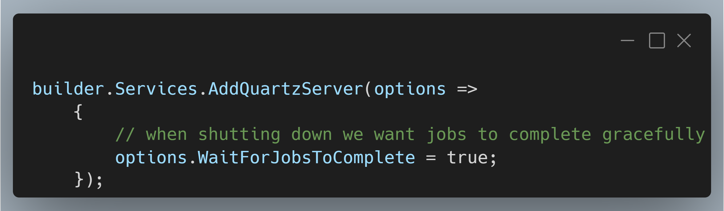
Scheduling with Quartz
Notes:
SCREENSHOT 1: https://carbon.now.sh/?bg=rgba%28171%2C+184%2C+195%2C+1%29&t=vscode&wt=boxy&l=text%2Fx-csharp&width=680&ds=true&dsyoff=20px&dsblur=68px&wc=true&wa=true&pv=11px&ph=10px&ln=false&fl=1&fm=Hack&fs=14px&lh=133%25&si=false&es=4x&wm=false&code=using%2520Quartz%253B%250A%252F%252F%2520...%250Abuilder.Services.AddQuartz%28q%2520%253D%253E%250A%2520%2520%2520%2520%257B%250A%2520%2520%2520%2520%2520%2520%2520%2520q.UseMicrosoftDependencyInjectionJobFactory%28%29%253B%250A%250A%2520%2520%2520%2520%2520%2520%2520%2520%252F%252F%2520base%2520Quartz%2520scheduler%252C%2520job%2520and%2520trigger%2520configuration%250A%2520%2520%2520%2520%2520%2520%2520%2520var%2520jobKey%2520%253D%2520new%2520JobKey%28%2522CleanUpTempFolderJob%2522%29%253B%250A%2520%2520%2520%2520%2520%2520%2520%2520q.AddJob%253CCleanUpTempFolderJob%253E%28jobKey%252C%2520job%2520%253D%253E%2520job%250A%2520%2520%2520%2520%2520%2520%2520%2520%2520%2520%2520%2520.StoreDurably%28%29%250A%2520%2520%2520%2520%2520%2520%2520%2520%2520%2520%2520%2520.DisallowConcurrentExecution%28%29%250A%2520%2520%2520%2520%2520%2520%2520%2520%2520%2520%2520%2520.WithDescription%28%2522Cleans%2520up%2520the%2520temp%2520folder%2522%29%29%253B%250A%250A%2520%2520%2520%2520%2520%2520%2520%2520var%2520cronEvery30Seconds%2520%253D%2520%25220%252F30%2520*%2520*%2520%253F%2520*%2520*%2522%253B%250A%2520%2520%2520%2520%2520%2520%2520%2520q.AddTrigger%28trigger%2520%253D%253E%2520trigger%250A%2520%2520%2520%2520%2520%2520%2520%2520%2520%2520%2520%2520.ForJob%28jobKey%29%250A%2520%2520%2520%2520%2520%2520%2520%2520%2520%2520%2520%2520.WithCronSchedule%28cronEvery30Seconds%29%29%253B%2520%252F%252F%2520every%252030%2520seconds%250A%250A%2520%2520%2520%2520%257D%29%253B%250A%252F%252F%2520....
Screenshot 2: https://carbon.now.sh/?bg=rgba%28171%2C+184%2C+195%2C+1%29&t=vscode&wt=boxy&l=text%2Fx-csharp&width=680&ds=true&dsyoff=20px&dsblur=68px&wc=true&wa=true&pv=11px&ph=10px&ln=false&fl=1&fm=Hack&fs=14px&lh=133%25&si=false&es=4x&wm=false&code=builder.Services.AddQuartzServer%28options%2520%253D%253E%250A%2520%2520%2520%2520%257B%250A%2520%2520%2520%2520%2520%2520%2520%2520%252F%252F%2520when%2520shutting%2520down%2520we%2520want%2520jobs%2520to%2520complete%2520gracefully%250A%2520%2520%2520%2520%2520%2520%2520%2520options.WaitForJobsToComplete%2520%253D%2520true%253B%250A%2520%2520%2520%2520%257D%29%253B

Slide 35
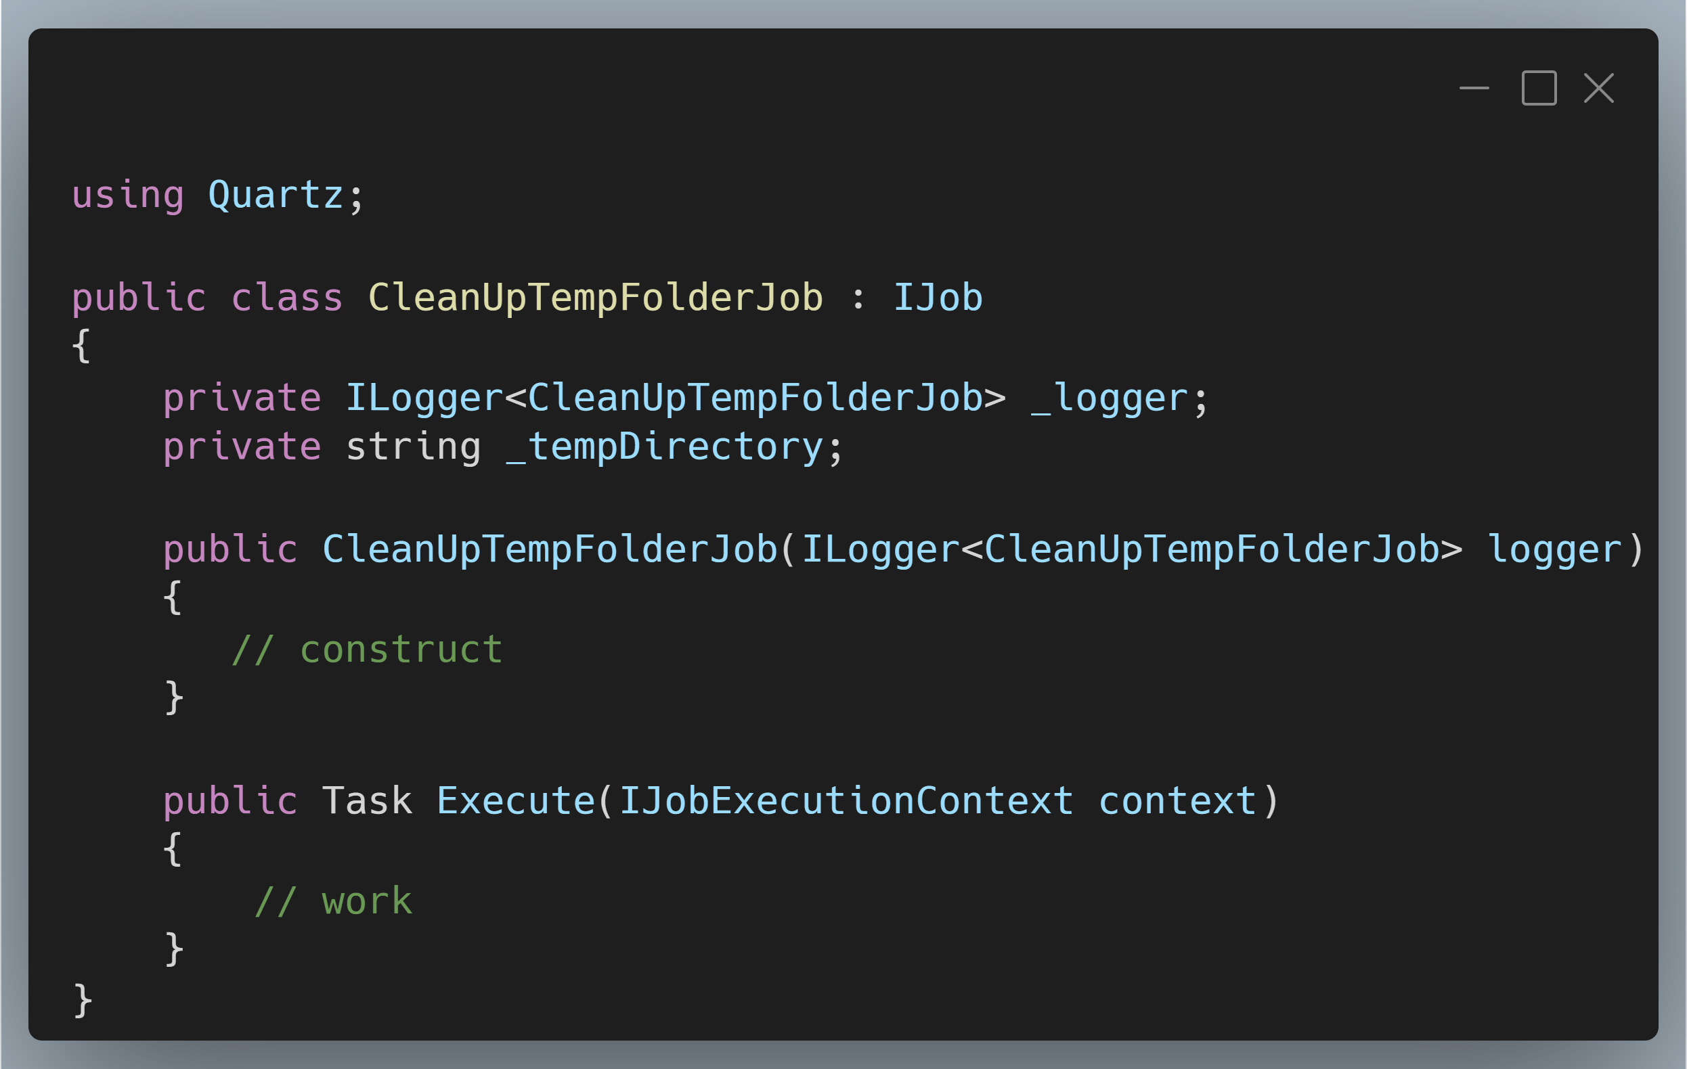
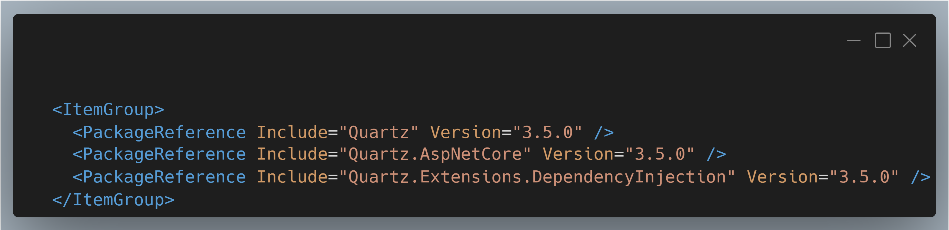
Scheduling with Quartz

Slide 36
Demo
Quartz

Slide 37
Quartz
Pros
Precise scheduling and timing!
One off jobs as you want to schedule them
Separate “job server” so your app isn’t doing dual duty
Cons
Locking into Quartz jobs
Additional configuration to tie into DI framework

Slide 38
HangFire

Slide 39
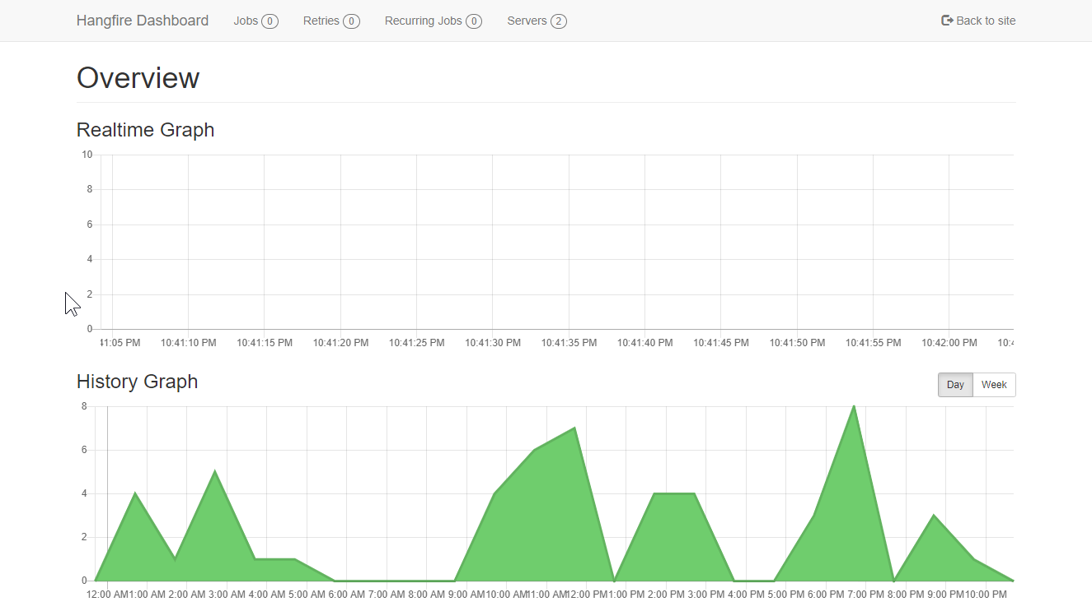
HangFire

Slide 40
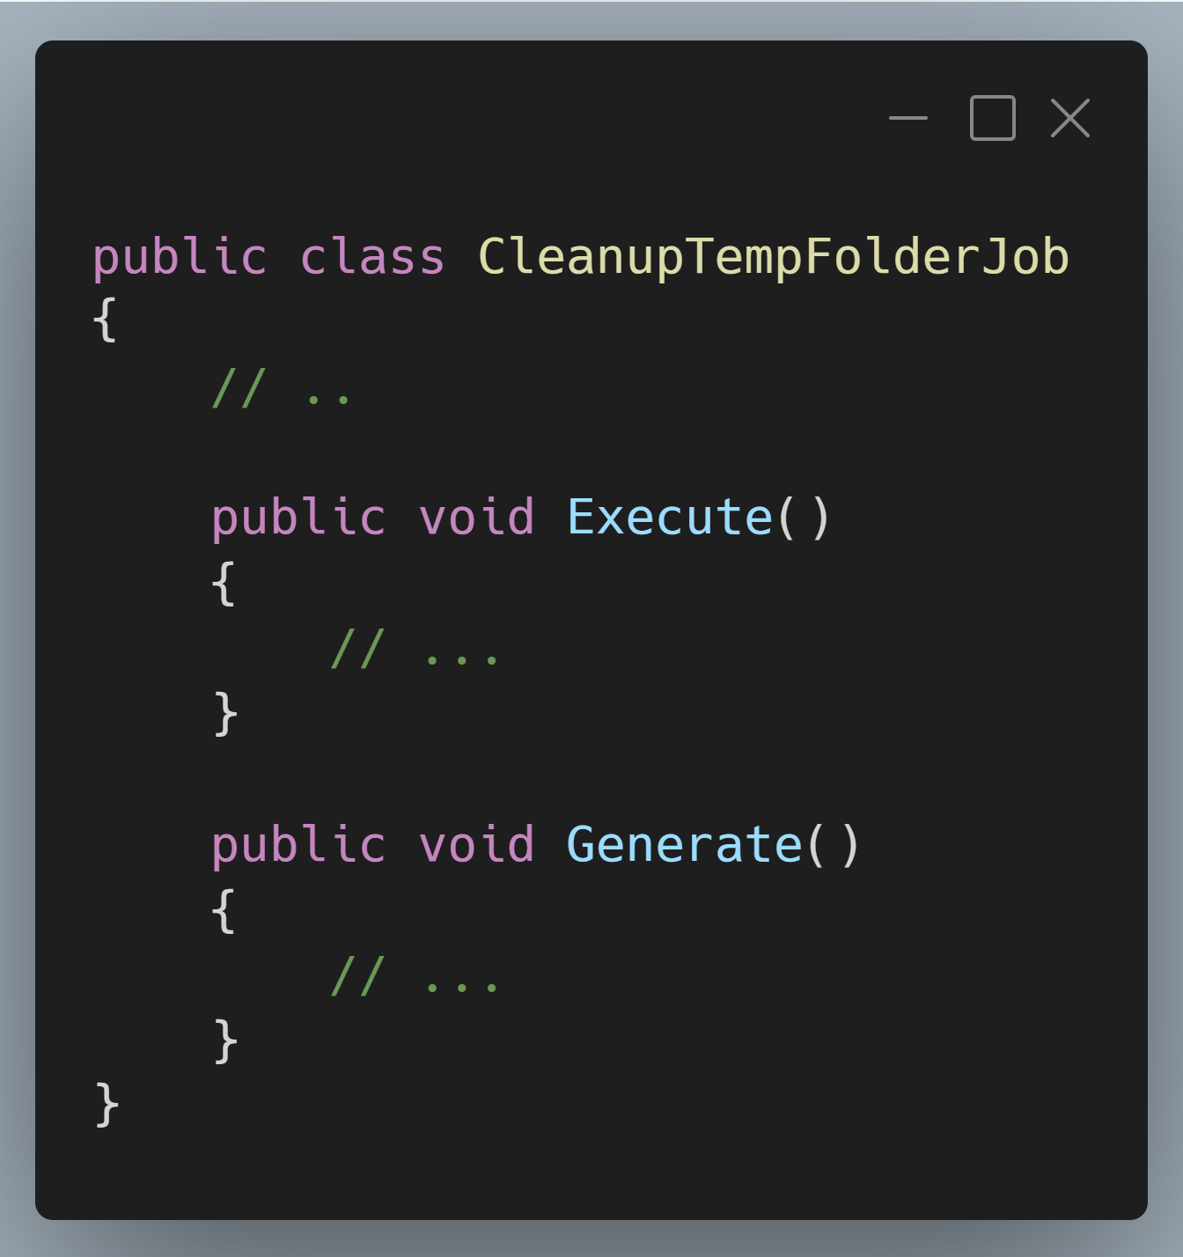
HangFire
Notes:
SCREENSHOT: https://carbon.now.sh/?bg=rgba%28171%2C+184%2C+195%2C+1%29&t=vscode&wt=boxy&l=text%2Fx-csharp&width=680&ds=true&dsyoff=20px&dsblur=68px&wc=true&wa=true&pv=11px&ph=10px&ln=false&fl=1&fm=Hack&fs=14px&lh=133%25&si=false&es=4x&wm=false&code=public%2520class%2520CleanupTempFolderJob%250A%257B%250A%2520%2520%2509%252F%252F%2520..%250A%250A%2520%2520%2520%2520public%2520void%2520Execute%28%29%250A%2520%2520%2520%2520%257B%250A%2509%2509%252F%252F%2520...%250A%2520%2520%2520%2520%257D%250A%250A%2520%2520%2520%2520public%2520void%2520Generate%28%29%250A%2520%2520%2520%2520%257B%250A%2520%2520%2520%2520%2520%2520%2520%2520%252F%252F%2520...%250A%2520%2520%2520%2520%257D%250A%257D

Slide 41
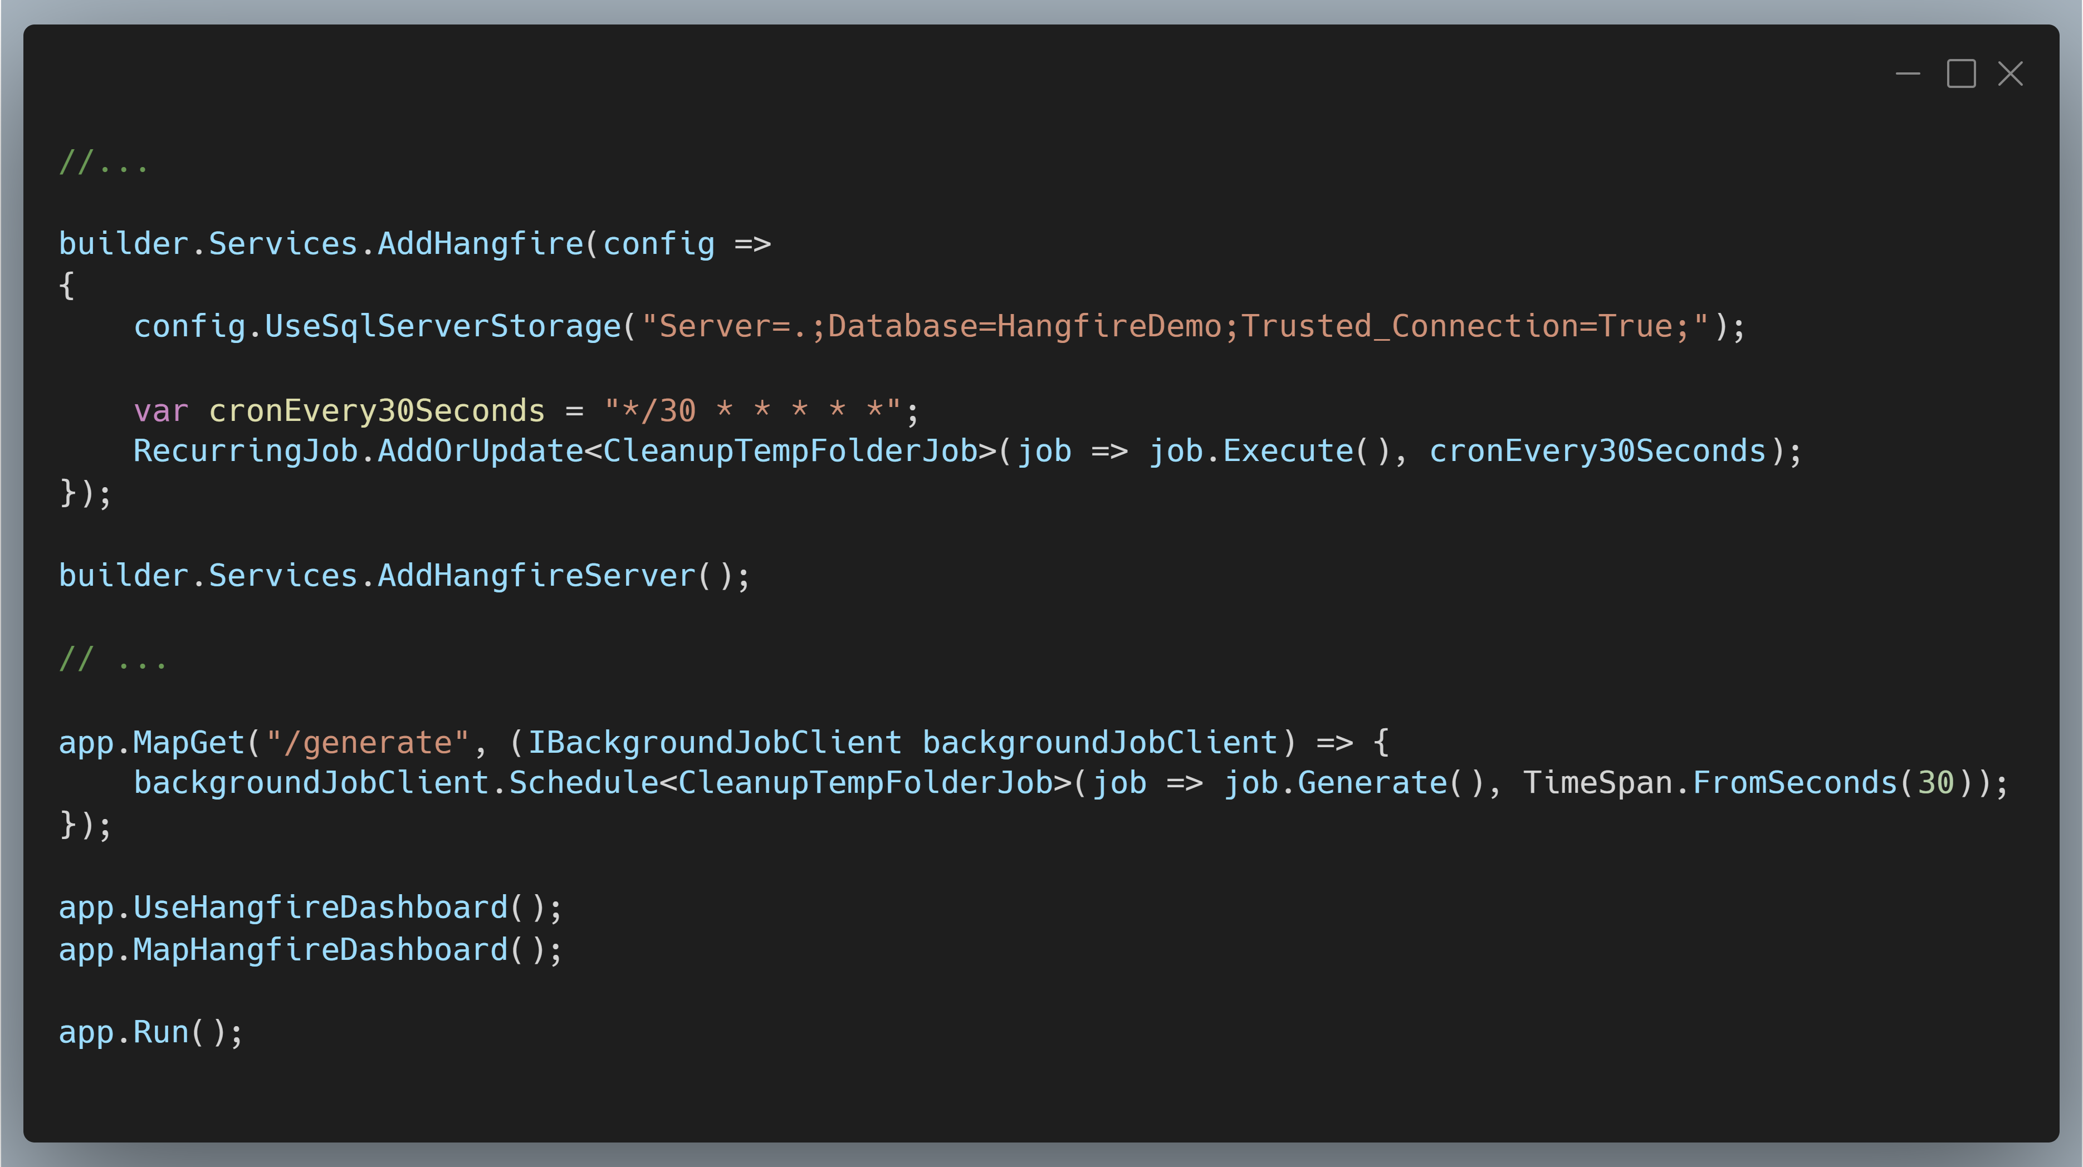
HangFire
Notes:
Screenshot: https://carbon.now.sh/?bg=rgba%28171%2C+184%2C+195%2C+1%29&t=vscode&wt=boxy&l=text%2Fx-csharp&width=680&ds=true&dsyoff=20px&dsblur=68px&wc=true&wa=true&pv=11px&ph=10px&ln=false&fl=1&fm=Hack&fs=14px&lh=133%25&si=false&es=4x&wm=false&code=%252F%252F...%250A%250Abuilder.Services.AddHangfire%28config%2520%253D%253E%250A%257B%250A%2520%2520%2520%2520config.UseSqlServerStorage%28%2522Server%253D.%253BDatabase%253DHangfireDemo%253BTrusted_Connection%253DTrue%253B%2522%29%253B%250A%250A%2520%2520%2520%2520var%2520cronEvery30Seconds%2520%253D%2520%2522*%252F30%2520*%2520*%2520*%2520*%2520*%2522%253B%250A%2520%2520%2520%2520RecurringJob.AddOrUpdate%253CCleanupTempFolderJob%253E%28job%2520%253D%253E%2520job.Execute%28%29%252C%2520cronEvery30Seconds%29%253B%250A%257D%29%253B%250A%250Abuilder.Services.AddHangfireServer%28%29%253B%250A%250A%252F%252F%2520...%250A%250Aapp.MapGet%28%2522%252Fgenerate%2522%252C%2520%28IBackgroundJobClient%2520backgroundJobClient%29%2520%253D%253E%2520%257B%250A%2520%2520%2520%2520backgroundJobClient.Schedule%253CCleanupTempFolderJob%253E%28job%2520%253D%253E%2520job.Generate%28%29%252C%2520TimeSpan.FromSeconds%2830%29%29%253B%250A%257D%29%253B%250A%250Aapp.UseHangfireDashboard%28%29%253B%250Aapp.MapHangfireDashboard%28%29%253B%250A%250Aapp.Run%28%29%253B%250A

Slide 42
Demo
HangFire

Slide 43
HangFire
Pros
Precise scheduling and timing!
One off jobs as you want to schedule them
Strongly typed jobs
UI is amazing
Cons
External data store is required – default to SQL Server
Best data stores are paywalled
Separate job server is a PAIN IN THE BUTT

Slide 44
Courses

Slide 45
Azure Functions

Slide 46
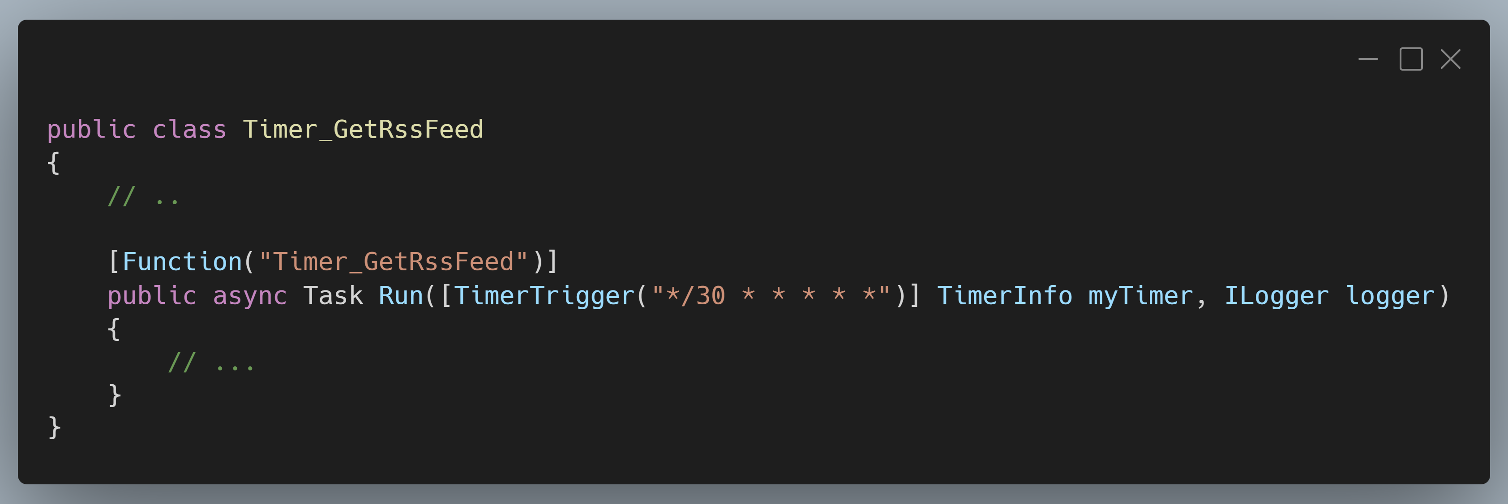
Azure Functions
Notes:
QueueTrigger
HttpTrigger
Maybe discuss service bus topics too?
SCREENSHOT: https://carbon.now.sh/?bg=rgba%28171%2C+184%2C+195%2C+1%29&t=vscode&wt=boxy&l=text%2Fx-csharp&width=680&ds=true&dsyoff=20px&dsblur=68px&wc=true&wa=true&pv=11px&ph=10px&ln=false&fl=1&fm=Hack&fs=14px&lh=133%25&si=false&es=4x&wm=false&code=public%2520class%2520Timer_GetRssFeed%250A%257B%250A%2509%252F%252F%2520..%250A%2520%2520%250A%2520%2520%2520%2520%255BFunction%28%2522Timer_GetRssFeed%2522%29%255D%250A%2520%2520%2520%2520public%2520async%2520Task%2520Run%28%255BTimerTrigger%28%2522*%252F30%2520*%2520*%2520*%2520*%2520*%2522%29%255D%2520TimerInfo%2520myTimer%252C%2520ILogger%2520logger%29%250A%2520%2520%2520%2520%257B%250A%2520%2520%2520%2520%2520%2520%2520%2520%252F%252F%2520...%250A%2520%2520%2520%2520%257D%250A%257D

Slide 47
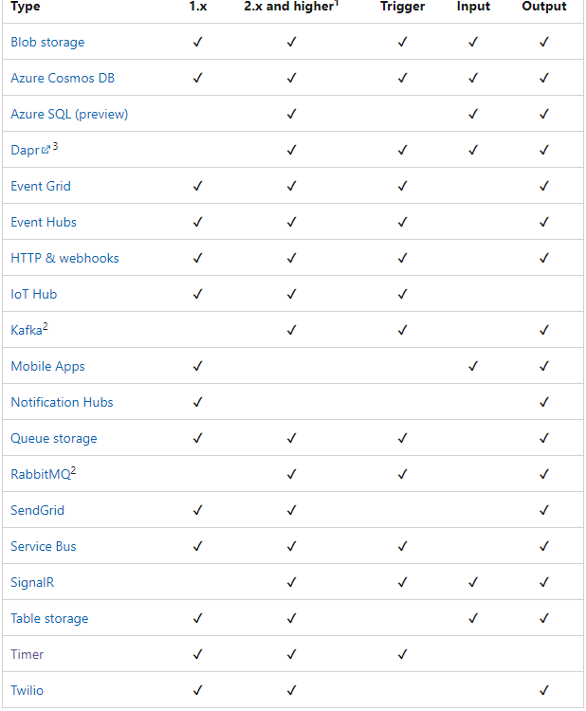
Notes:
Triggers – input and output bindings

Slide 48
Demo
Azure Functions

Slide 49
Azure Functions
Pros
Precise scheduling and timing!
Tons of trigger options
CLOUD SCALE
Tasks are independently resilient
Cons
Azure requirement

Slide 50
Conclusions
Notes:
Important to abstract out background tasks from your UI or front facing work

Slide 51
Thanks!

